Slide 1
AI CRICKET COACH

Slide 2
An AI backed solution that classifies ball deliveries using advanced video analytics and provides batsman with an end to end coaching assistance in an enhanced WebVR environment.
The features of the app include:
Generation of detailed analysis report of a ball delivery with reference to the records of the batman in the database.
Recommendation of the most ideal shot type, reaction time and shot power for a selected ball delivery.
A one to one Web-VR coaching setup for the batsman to learn any shot of his favorite player for a selected ball delivery where the batsman is provided with a success score that determines the closeness of his shot to that of his reference player real-time.

Slide 3
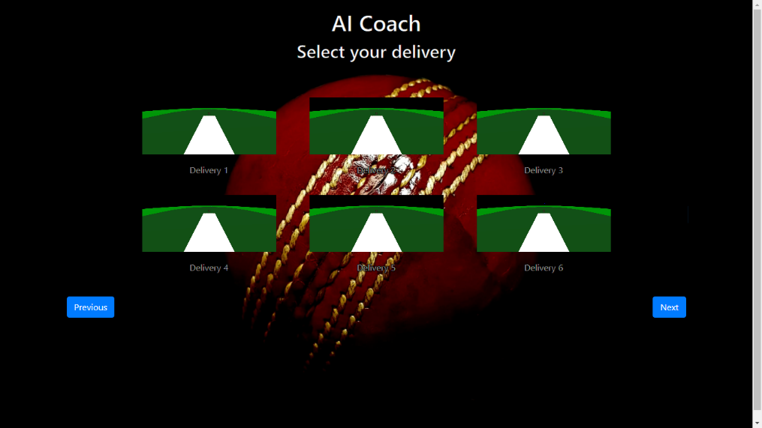
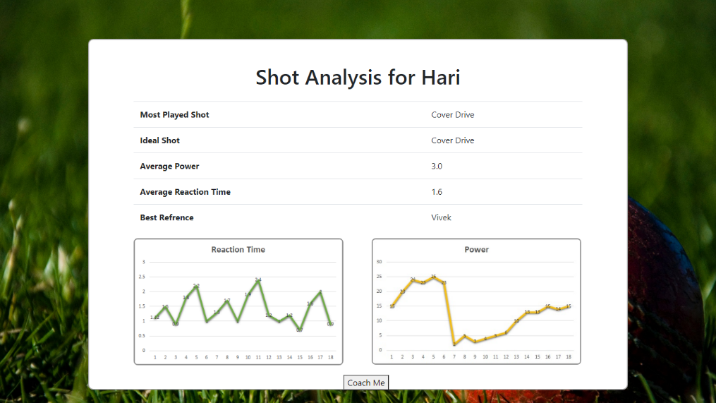
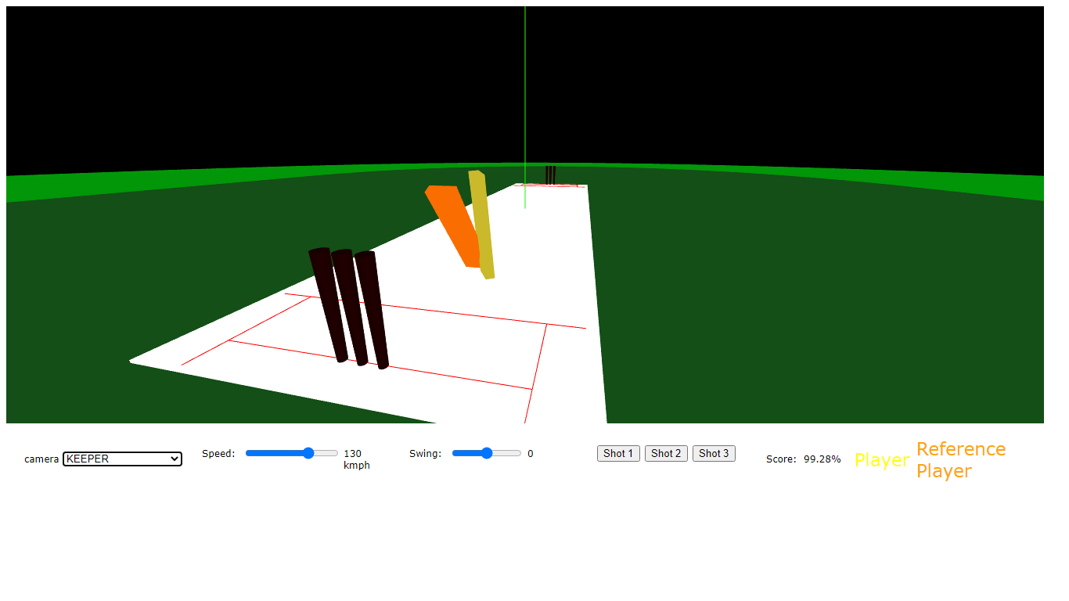
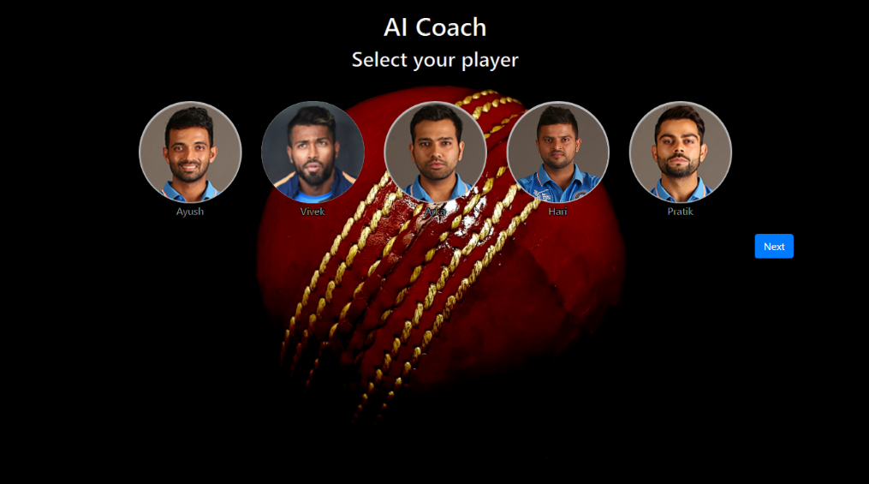
APP FLOW

Slide 4
Thank you

